Slide 1
Slide Set 5
Arrays within a class
Array of objects
Object as function arguments
Returning objects from function
Dynamic Memory Allocation
Reference Variables

Slide 2
Arrays within a class
Arrays can be used as class member variables.
a is an integer array.
It is declared as a private data member of the class array.
Can be used in class member functions.
class array
{ int a[10];
public:
void setVal();
void sort();
void display();
};

Slide 3
Example
#include<iostream>
using namespace std;
class array
{ int a[10];
public:
void setVal()
{ for (int i = 0; i < 10; i++)
cin >> a[i]; }
void sort()
{ for (int i = 0; i < 9; i++)
for (int j = 0; j < 10 - i - 1; j++)
{ if (a[j] > a[j + 1])
{ a[j] = a[j] + a[j + 1];
a[j + 1] = a[j] - a[j + 1];
a[j] = a[j] - a[j + 1]; } } }

Slide 4
Contd…
void display()
{ for (int i = 0; i < 10; i++)
cout << a[i] << '\t';
}
};
int main()
{
array Arr;
Arr.setVal();
Arr.sort();
cout << "Sorted sequence is:\n";
Arr.display();
}
Output:
10 9 8 7 6 5 4 3 2 1
Sorted sequence is:
1 2 3 4 5 6 7 8 9 10

Slide 5
Array of objects
Means array of variables of type class.
The syntax for declaring and using an object array is exactly the same as it is for any other type of array.
Use usual array-accessing methods to access individual elements, and then the dot member operator to access the member functions.
An array of objects is stored inside the memory in the same way as a multi-dimensional array.

Slide 6
Contd…
class emp
{ char name[10];
int age;
public:
void getData();
void putData();
};
emp manager[3];
// Array of manager
emp worker[10];
// Array of worker
Accessing member functions.
manager[i].getData();
manager[i].putData();

Slide 7
Contd…
An array of objects is stored similar to multi-dimensional array.
emp manager[3];
name |  | manager[0]
age
name |  | manager[1]
age
name |  | manager[2]
age

Slide 8
Example
#include<iostream>
using namespace std;
class emp
{ char name[10];
int age;
public:
void getData();
void putData();
};
void emp :: getData()
{ cout << "Enter Name: "; cin >> name;
cout << "Enter Age: "; cin >> age; }
void emp :: putData()
{ cout << "\tName: " << name << "\tAge: " << age << endl; }

Slide 9
Contd…
int main()
{ emp manager[3];
for (int i = 0; i < 3; i++)
{ cout << "\nEnter details of manager " << i + 1 << endl;
manager[i].getData();
}
for (int i = 0; i < 3; i++)
{ cout << "\nManager " << i + 1;
manager[i].putData();
}
return 0;
}

Slide 10
Output
Enter details of manager 1
Enter Name: Arun
Enter Age: 50
Enter details of manager 2
Enter Name: Amita
Enter Age: 35
Enter details of manager 3
Enter Name: Yashika
Enter Age: 45
Manager 1 Name: Arun Age: 50
Manager 2 Name: Amita Age: 35
Manager 3 Name: Yashika Age: 45

Slide 11
Objects as function arguments
Object can be passed as a function argument, like any other data type to member functions as well as non-member functions.
Pass-by-value
Pass-by-reference

Slide 12
Example 1
#include <iostream>
using namespace std;
class Convert
{ public :
int i;
void increment(Convert obj)
{ obj.i=obj.i*2;
cout << "Value of i in member function : " << obj.i;
}
};
int main ()
{ Convert obj1;
obj1.i=3; obj1.increment(obj1);
cout << "\nValue of i in main : " << obj1.i << "\n";
return 0; }
Output:
Value of i in member function : 6
Value of i in main : 3

Slide 13
Example 2
#include <iostream> using namespace std; class myclass { int i; public: myclass(int n); ~myclass(); void set_i(int n) { i=n; } int get_i() { return i; } }; myclass::myclass(int n) { i = n; cout << "Constructing " << i << "\n"; } myclass::~myclass() { cout << "Destroying " << i << "\n"; } void f(myclass ob);
int main() { myclass o(1); f(o); cout << "This is i in main: "; cout << o.get_i() << "\n"; return 0; } void f(myclass ob) { ob.set_i(2); cout << "This is local i: " << ob.get_i(); cout << "\n"; }
Output Constructing 1 This is local i: 2 Destroying 2 This is i in main: 1 Destroying 1

Slide 14
Example 3 (Pass-by-reference)
#include <iostream>
using namespace std;
class Convert
{ public :
int i;
void increment(Convert &obj)
{ obj.i=obj.i*2;
cout << "Value of i in member function : " << obj.i;
}
};
int main ()
{ Convert obj1;
obj1.i=3; obj1.increment(obj1);
cout << "\nValue of i in main : " << obj1.i << "\n";
return 0; }
Output:
Value of i in member function : 6
Value of i in main : 6

Slide 15
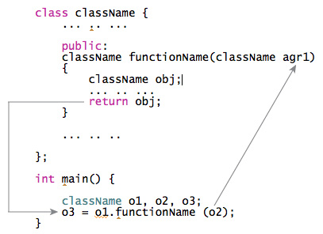
Returning Objects

Slide 16
Example 1
#include <iostream> using namespace std; class myclass { int i; public: void set_i(int n) { i=n; } int get_i() { return i; } };
myclass f(); //return object of type myclass
int main() { myclass o; o = f();
cout << o.get_i() << "\n"; return 0; }
myclass f() { myclass x; x.set_i(1); return x; }
Output:
1

Slide 17
Dynamic Memory Allocation
Reference Variables

Slide 18
Dynamic Allocation Operators
new
Allocates memory and returns a pointer to the start of it. Let p_var is a pointer variable of any data type type, then
p_var = new type;
delete
Frees memory previously allocated using new.
delete p_var;

Slide 19
Operator new Syntax
new DataType
new DataType [IntExpression]
If memory is available, in an area called the heap (or free store) new allocates the requested object or array, and returns a pointer to (address of ) the memory allocated.
Otherwise, program terminates with error message.
The dynamically allocated object exists until the delete operator destroys it.
19

Slide 20
Operator new
char* ptr;
ptr = new char;
*ptr = ‘B’;
cout << *ptr;
NOTE: Dynamic data has no variable name
2000
???
ptr
5000
5000
‘B’

Slide 21
The NULL Pointer
There is a pointer constant called the “null pointer” denoted by NULL
But NULL is not memory address 0.
NOTE: It is an error to dereference a pointer whose value is NULL. Such an error may cause your program to crash, or behave erratically. It is the programmer’s job to check for this.
while (ptr != NULL) {
. . . // ok to use *ptr here
}

Slide 22
Operator delete Syntax
delete Pointer
delete [ ] Pointer
The object or array currently pointed to by Pointer is deallocated, and the value of Pointer is undefined. The memory is returned to the free store.
Good idea to set the pointer to the released memory to NULL
Square brackets are used with delete to deallocate a dynamically allocated array.
22

Slide 23
Operator delete
char* ptr;
ptr = new char;
*ptr = ‘B’;
cout << *ptr;
delete ptr;
2000
ptr
5000
???
5000
‘B’
NOTE:
delete deallocates the
memory pointed to by ptr

Slide 24
Example
char *ptr ;
ptr = new char[ 5 ];
strcpy( ptr, “Bye” );
ptr[ 0 ] = ‘u’;
delete [] ptr;
ptr = NULL;
3000
ptr
6000
NULL
???
???
6000
‘B’ ‘y’ ‘e’ ‘\0’
‘u’
// deallocates the array pointed to by ptr
// ptr itself is not deallocated
// the value of ptr becomes undefined

Slide 25
Example
#include<iostream>
using namespace std;
int main()
{
int *p;
p = new int(87);
cout << "Value is: " << *p;
delete p;
return 0;
}

Slide 26
Some points…
In case of insufficient memory, new returns null pointer.
So check for the pointer produced by new before using it.
…..
…..
p = new int;
If(!p)
count << "Allocation failed\n";
…..
…..

Slide 27
Allocating Arrays
Allocate arrays using new by using : p_var = new array_type [size];
Here, size specifies the number of elements in the array.
To free an array, use delete: delete [ ] p_var; Here, the [ ] informs delete that an array is being released.

Slide 28
Example
#include <iostream>
#include <new>
using namespace std;
int main()
{ int *p, i;
p= new int[10]; for(i=0; i<10; i++ ) p[i] = i; for(i=0; i<10; i++) cout << p[i] << " "; delete [] p; // release the array return 0;
}

Slide 29
Allocating Objects
Allocate objects dynamically by using new.
An object is created and a pointer is returned to it.
The dynamically created object acts just like any other object. When it is created, its constructor function (if it has one) is called.
When the object is freed, its destructor function is executed.

Slide 30
Example
#include <iostream> #include <new> #include <cstring> using namespace std; class balance { double cur_bal; char name[80]; public: void set(double n, char *s) { cur_bal = n; strcpy(name, s); } void get_bal(double &n, char *s) { n = cur_bal; strcpy(s, name); } };
int main() { balance *p; char s[80]; double n;
p=new balance; p->set(12387.87, "Ralph Wilson"); p->get_bal(n, s); cout << s << "'s balance is: " << n; cout << "\n"; delete p; return 0; }

Slide 31
Advantages
Automatically computes size of the data object, no need to use sizeof operator.
Automatically returns correct pointer type, no need to use type cast.
Possible to initialize the object during the memory space creation.
New and delete can be overloaded.

Slide 32
Reference variable
It provides an alias, an alternative name, for a previously defined variable.
Syntax:
data-type &reference-name = variable-name
Must be initialized at the time of declaration.
Example:
int x;
int *p = &x;
int &m = *p;
int n[10];
int &x = n[10];
char &a = '\n';

Slide 33
Reference Variables
Reference variable = alias for another variable
- Contains the address of a variable (like a pointer)
- No need to perform any dereferencing (unlike a pointer)
- Must be initialized when it is declared
int x = 5;
int &z = x; // z is another name for x
int &y ; //Error: reference must be initialized
cout << x << endl; -> prints 5
cout << z << endl; -> prints 5
z = 9; // same as x = 9;
cout << x << endl; -> prints 9
cout << z << endl; -> prints 9

Slide 34
Why Reference Variables
Are primarily used as function parameters
Advantages of using references:
you don’t have to pass the address of a variable
you don’t have to dereference the variable inside the called function

Slide 35
Example 1
#include <iostream>
Using namespace std;
// Function prototypes (required in C++)
void p_swap(int *, int *);
void r_swap(int&, int&);
int main (void){
int v = 5, x = 10;
cout << v << x << endl;
p_swap(&v,&x);
cout << v << x << endl;
r_swap(v,x);
cout << v << x << endl;
return 0;
}
void p_swap(int *a, int *b)
{
int temp;
temp = *a; (2)
*a = *b; (3)
*b = temp;
}
void r_swap(int &a, int &b)
{
int temp;
temp = a; (2)
a = b; (3)
b = temp;
}

Slide 36
Example 2
#include <iostream>
using namespace std;
int main()
{ int a = 10;
int &ref = a;
cout << a << " " << ref << endl;
ref += 5;
cout << a << " " << ref << endl;
return 0;
}

Slide 37
Example 3
#include<iostream>
using namespace std;
void add(int &n);
int main()
{ int number;
number = 34;
cout << " The initial value of number : " << number << endl;
add(number);
cout << " The final value of number : " << number << endl;
return(0); }
void add(int &n)
{ n = n + 6; }

Slide 38
Restrictions to References
Reference to another reference is not possible.
Address of a reference cannot be obtained.
Arrays of references cannot be created.
Pointer to a reference cannot be created.
Reference for a bit-field is not possible.
A reference variable must be initialized when it is declared unless it is a member of a class, a function parameter, or a return value.
Null references are prohibited.

Slide 39
Pointers to Objects
this Pointer
Pointers to class members

Slide 40
Pointers to Objects
When accessing members of a class given a pointer to an object, use the arrow (–>) operator instead of the dot operator.
#include <iostream> using namespace std; class cl { int i; public: cl(int j) { i=j; } int get_i() { return i; } };
int main() { cl ob(88), *p; p = &ob; // get address of ob cout << p->get_i(); // use -> to call get_i() return 0; }
Output
88

Slide 41
Example
int main()
{ cl ob[3] = {1, 2, 3}; cl *p; int i;
p = ob; // get start of array for(i=0; i<3; i++)
{ cout << p->get_i() << "\n"; p++; // point to next object } return 0;
}
#include <iostream> using namespace std; class cl
{ int i; public: cl()
{
i=0;
} cl(int j)
{ i=j; }
int get_i() { return i; }
};
Output
1
2
3

Slide 42
this pointer
Member functions of every object have access to a special constant pointer named this.
It points to the object itself.
It is passed automatically as an implicit argument to the invoking member function.
class ABC
{ int a;
public:
void set()
{ a = 10; }
};
class ABC
{ int a;
public:
void set()
{ this->a = 10; }
};

Slide 43
Contd…
Static member functions do not have 'this' pointer as they can be called without any object using the class name.
Not passed to friend functions as they are not member functions of a class.
Used when a binary operator is overloaded using a member function.
Used to return the object it points to.

Slide 44
Note
It's important to note that this is a const pointer.
We can change the value of the object it points to, but we cannot make it a point to any other object.
This is why we can not declare and make assignments to the this pointer.

Slide 45
Example 1
#include <iostream>
using namespace std;
class ABC
{ private:
char charray[10];
public:
void reveal()
{
cout << "\nMy object's address is " << this;
}
};
int main()
{ ABC w1, w2;
w1.reveal();
w2.reveal();
cout << endl;
return 0;
}
Output
My object's address is 0x6ffe40
My object's address is 0x6ffe30

Slide 46
Example 2
#include<iostream>
#include<cstring>
using namespace std;
class person
{ char name[20];
int age;
public:
void setData(const char *s, int a)
{ strcpy(name, s);
age = a; }
person& greater(person &x)
{ if(x.age >= age) return x;
else return *this; }
void display()
{ cout << name << " with age " << age; }
};

Slide 47
Contd…
int main()
{ person p1,p2,p3;
p1.setData("Abha", 21);
p2.setData("Akhil", 29);
p3.setData("Mitali", 31);
person p = p1.greater(p2);
cout << "Elder person is: ";
p.display();
p = p2.greater(p3);
cout << endl << "Elder person is: ";
p.display();
return 0;
}
Output
Elder person is: Akhil with age 29
Elder person is: Mitali with age 31

Slide 48
Pointers to Class Members
A special type of pointer that "points" generically to a member of a class, not to a specific instance of that member in an object.
This sort of pointer is called a pointer to a class member or a pointer-to-member.
A pointer to a member is not the same as a normal C++ pointer.
Instead, a pointer to a member provides only an offset into an object of the member's class at which that member can be found.

Slide 49
Contd…..
Since member pointers are not true pointers, the . and -> cannot be applied to them.
To access a member of a class given a pointer to it, use the special pointer-to-member operators .* and –>*.
Their job is to allow you to access a member of a class given a pointer to that member.

Slide 50
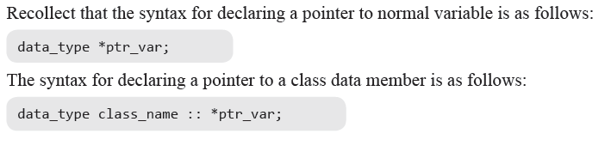
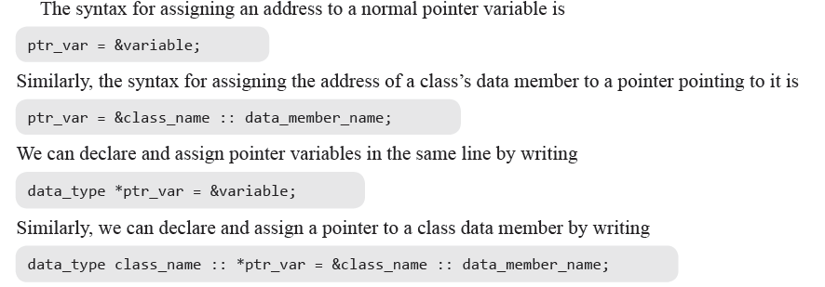
Declaring and Assigning Pointer to Data Members of a Class

Slide 51
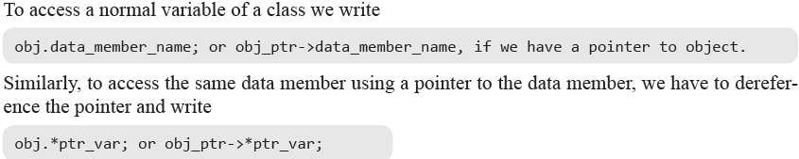
Accessing Data Members Using Pointers

Slide 52
Example
#include<iostream>
using namespace std;
class Test
{
public :
int x;
void show_data();
};
void Test :: show_data()
{
cout<<“\n x=“<<x;
}
int main()
{
Test t;
int Test :: *ptr=&Test::x;
t.*ptr=20;
t.show_data();
Test *tp= new Test;
tp->*ptr=80;
tp->show_data();
return 0;
}
Output
X=20
X=80

Slide 53
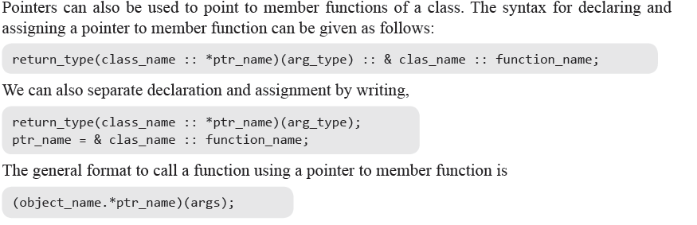
Pointer to member function

Slide 54
Example 1
int main()
{
// declare pointer to data member
int X::*ptiptr = &X::a;
// declare a pointer to member function
void (X::* ptfptr) (int) = &X::f;
// create an object of class type X
X xobject;
// initialize data member
xobject.*ptiptr = 10;
cout << "The value of a is " << xobject.*ptiptr << endl;
// call member function
(xobject.*ptfptr) (20);
}
#include <iostream>
using namespace std;
class X
{
public:
int a;
void f(int b)
{
cout << "The value of b is "<< b << endl;
}
};
Output
The value of a is 10
The value of b is 20

Slide 55
Example 2
#include <iostream> using namespace std; class cl
{ public: cl(int i) { val=i; } int val; int double_val()
{ return val+val; }
}; int main() { int cl::*data; // data member pointer int (cl::*func)(); // function member pointer cl ob1(1), ob2(2); // create objects
data = &cl::val; // get offset of val func = &cl::double_val; // get offset of double_val() cout << "Here are values: "; cout << ob1.*data << " " << ob2.*data << "\n"; cout << "Here they are doubled: "; cout << (ob1.*func)() << " "; cout << (ob2.*func)() << "\n"; return 0; }
Output
Here are values: 1 2
Here they are doubled: 2 4

Slide 56
Thank You!

